Slide 1
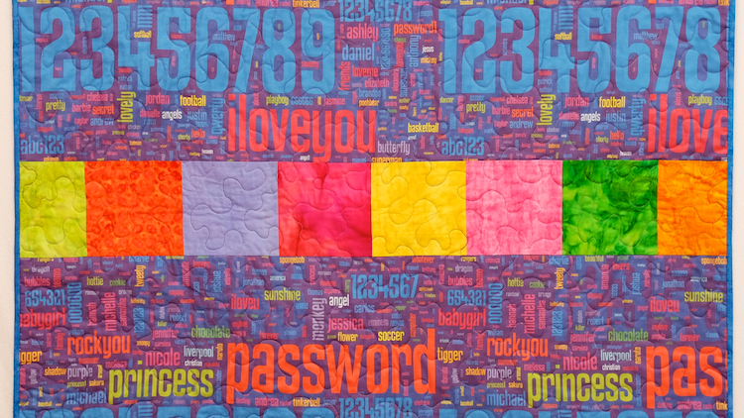
Authentication Vitaly Shmatikov
Image: Lorrie Cranor’s password quilt

Slide 2
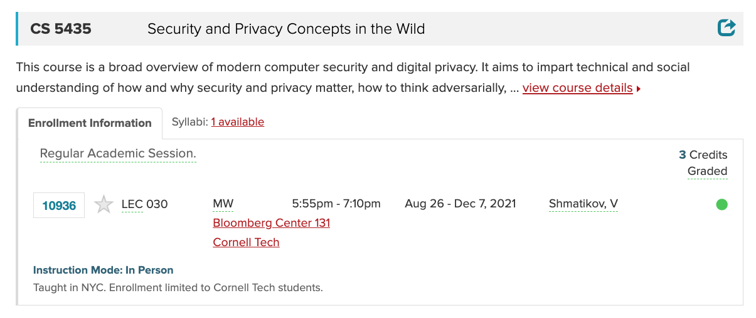
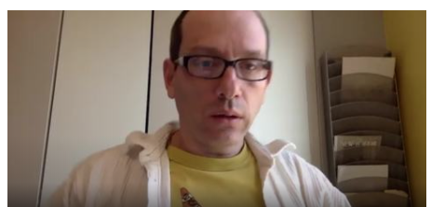



Slide 3
The Core Problem of Authentication
How do you prove to someone that you are who you claim to be?
Any system with access control must solve this problem
What you know: password, PIN, answers to questions only you know
What you are: biometrics
What you have: phone number, mobile device, secure token
Where you are: IP address, geolocation
Someone/something knows you: single sign-on (Cornell NetID), PKI

Slide 4
Authentication vs. Authorization & Access Control
Authentication: is the user (or program) who they claim they are?
Authorization: should user (or program) have access to a given resource?
Authorization decisions rely on correct authentication
Access control: policy and enforcement mechanism

Slide 5
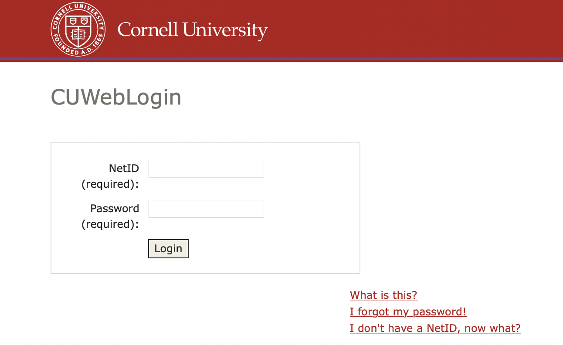
Password-Based Authentication
Easy to deploy
Easy to use (nothing to carry, etc.)
No simple alternative
User has a secret password.
System checks it to authenticate the user.
How is the password communicated?
How is the password stored?
How does the system check the password?
How easy is it to guess the password?

Slide 6
Attacks on Passwords
Online
Try to guess passwords by logging to a live system
Offline
Try to guess passwords in the (typically stolen) password database
Pre-computation can make offline attacks very fast
Phishing
Trick user into disclosing their password
Spear-phishing: phishing a specific user with personalized attacks

Slide 7
Passwords Are The Bane of Computer Security
Phishing and use of stolen credentials are the top two hacking techniques
Source: Verizon Data Breach Investigations Report
First step after any successful intrusion: install sniffer or keylogger to steal more passwords
Then run cracking tools on password files
Modern systems usually do not store passwords in the clear (how are they stored?)

Slide 8
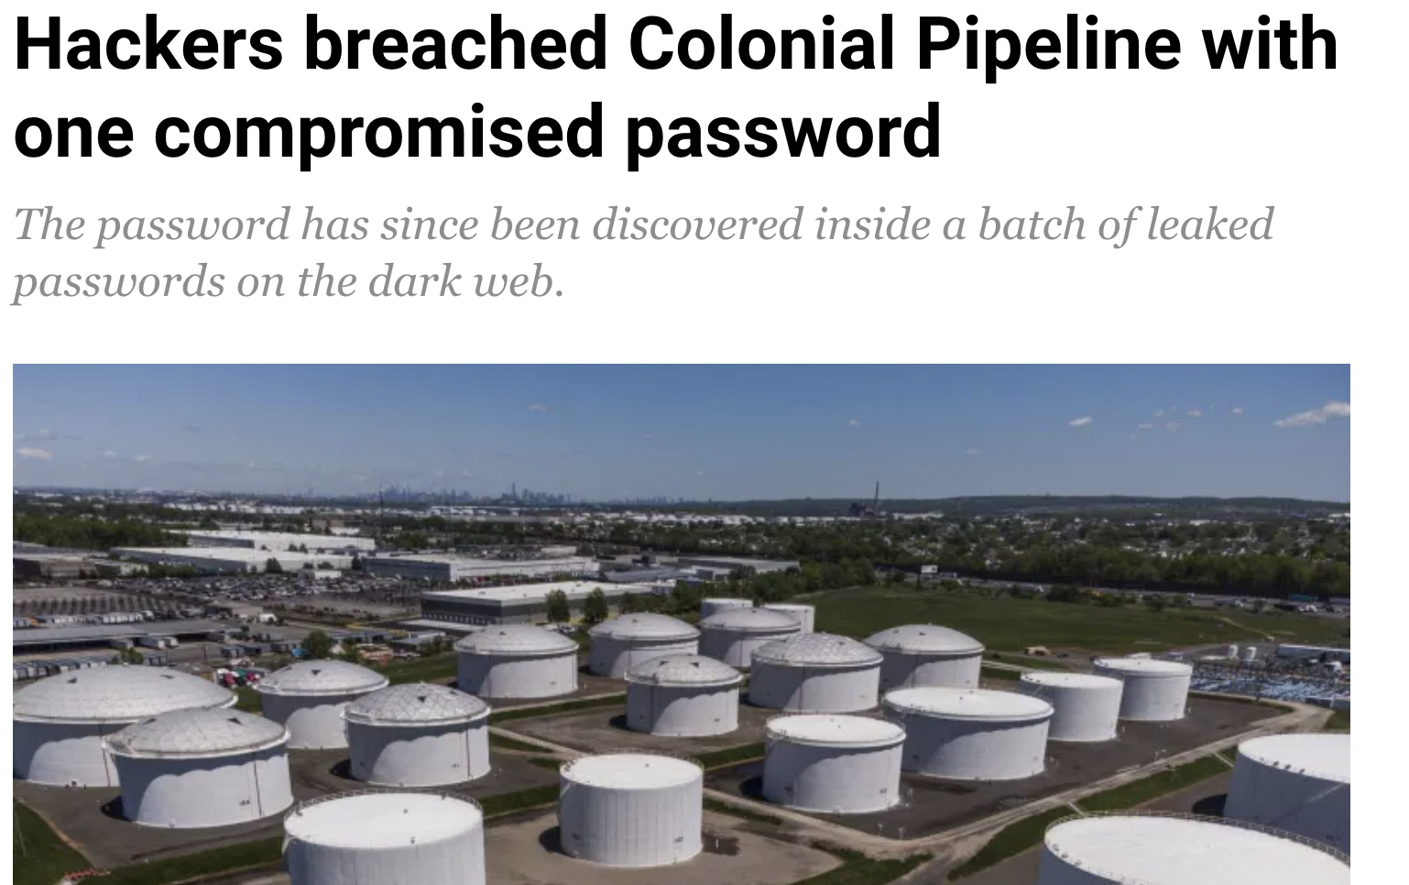

Hackers gained entry into the networks of Colonial Pipeline Co. on April 29 through a virtual private network account, which allowed employees to remotely access the company’s computer network
…
The account’s password has since been discovered inside a batch of leaked passwords on the dark web. That means a Colonial employee may have used the same password on another account that was previously hacked
…
The VPN account, which has since been deactivated, didn’t use multifactor authentication, a basic cybersecurity tool, allowing the hackers to breach Colonial’s network using just a compromised username and password.
https://www.aljazeera.com/economy/2021/6/4/hackers-breached-colonial-pipeline-with-one-compromised-password

Slide 9
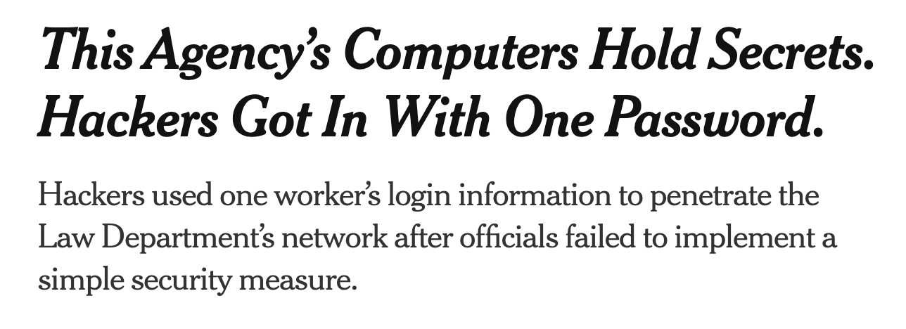
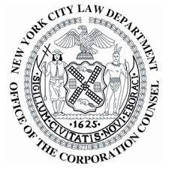
New York City’s Law Department holds some of the city’s most closely guarded secrets: evidence of police misconduct, the identities of young children charged with serious crimes, plaintiffs’ medical records and personal data for thousands of city employees.
…
the hack was enabled by the Law Department’s failure to implement a basic safeguard, known as multifactor authentication, more than two years after the city began requiring it
https://www.nytimes.com/2021/06/18/nyregion/nyc-law-department-hack.html

Slide 10
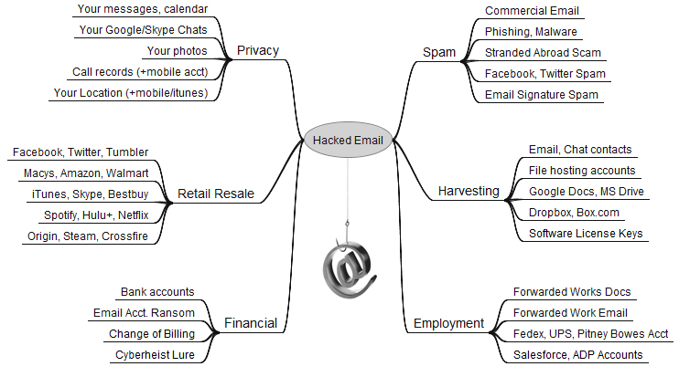
From Here to Eternity
https://krebsonsecurity.com/2019/01/773m-password-megabreach-is-years-old

Slide 11
Default Passwords
Examples from Mitnick’s “Art of Intrusion”
U.S. District Courthouse server: “public” / “public”
NY Times employee database: pwd = last 4 SSN digits
“Dixie bank”: break into router (pwd=“administrator”), then into bank server (pwd=“administrator”), install keylogger to snarf other passwords
“99% of people there used password123 as their password”
Mirai botnet (2016)
Used default passwords in IoT devices (Internet cameras, home routers, etc.) to stage a massive distributed denial-of-service flooding attack

Slide 12
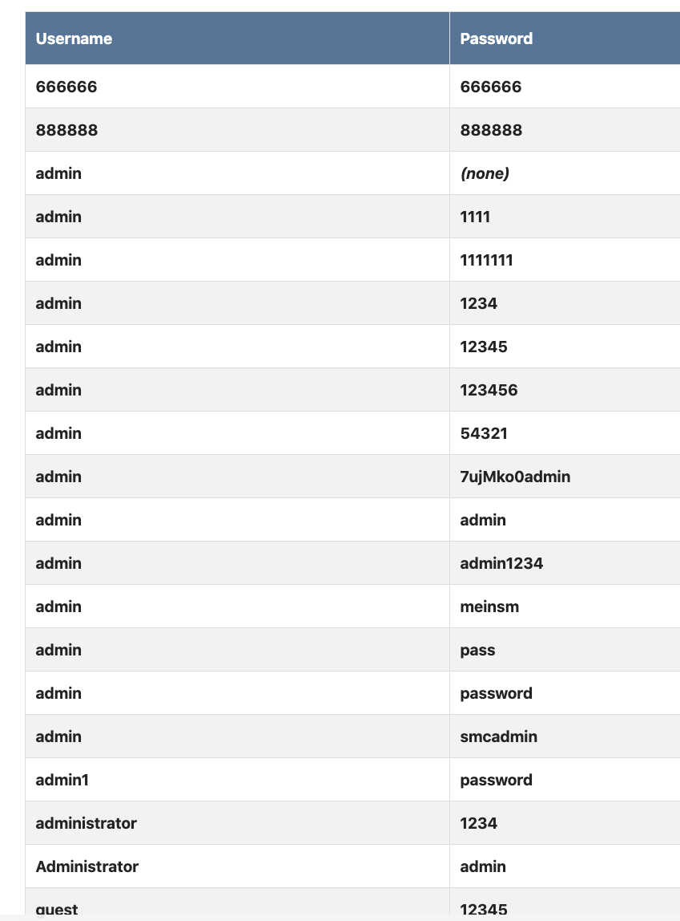
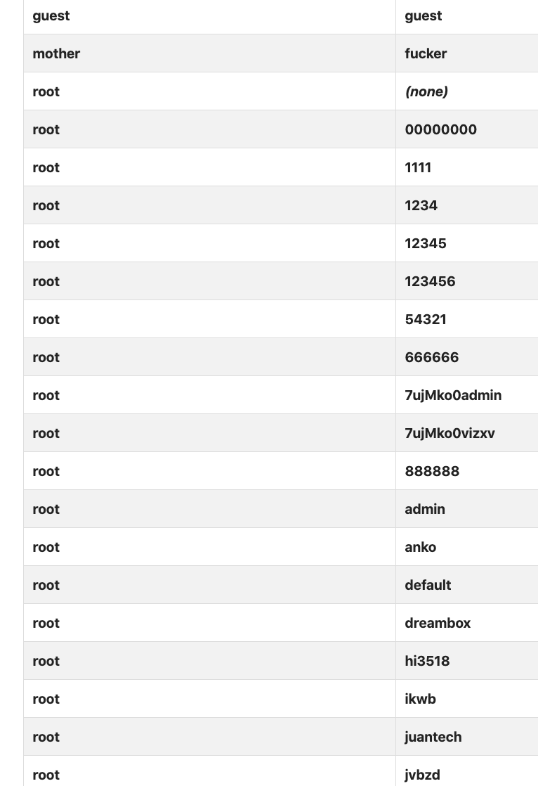
From Mirai’s Source Code

Slide 13
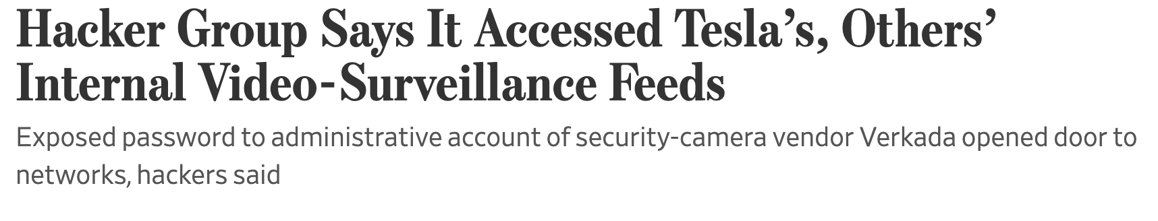
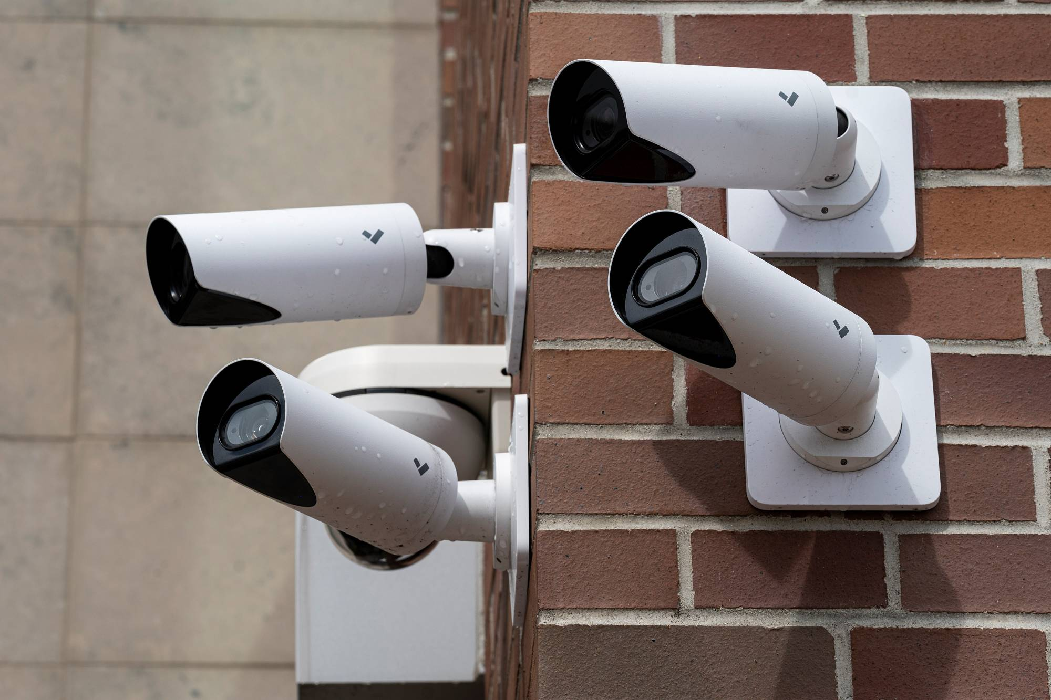
Tillie Kottmann, one of the hackers, said the group found a username and password for a Verkada administrative account on the internet, permitting them to obtain the footage. That included footage from 222 cameras placed inside various Tesla factories and warehouses, Kottmann said in a message.
In all, the group could have accessed material from 150,000 Verkada cameras
https://www.wsj.com/articles/hacker-group-says-it-accessed-teslas-others-internal-video-surveillance-feeds-11615396594

Slide 14
Old Password Surveys
Klein (1990) and Spafford (1992)
2.7% guessed in 15 minutes, 21% in a week
Much more computing power is available now!
U. of Michigan: 5% of passwords were “goblue”
How many passwords at this university involve “cornell”, “big red”, etc.?
Zviran and Haga (1999)
Password usage at a DoD facility in California
80% of passwords were 4-7 characters in length, 80% used alphabetic characters only, 80% of the users had never changed their password

Slide 15


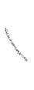
Hack (2009)
“Social gaming” company
Database with 32 million user passwords from partner social networks
Passwords stored in the clear
December 2009: entire database hacked using a SQL injection attack and posted on the Internet
More about SQL injection later

Slide 16
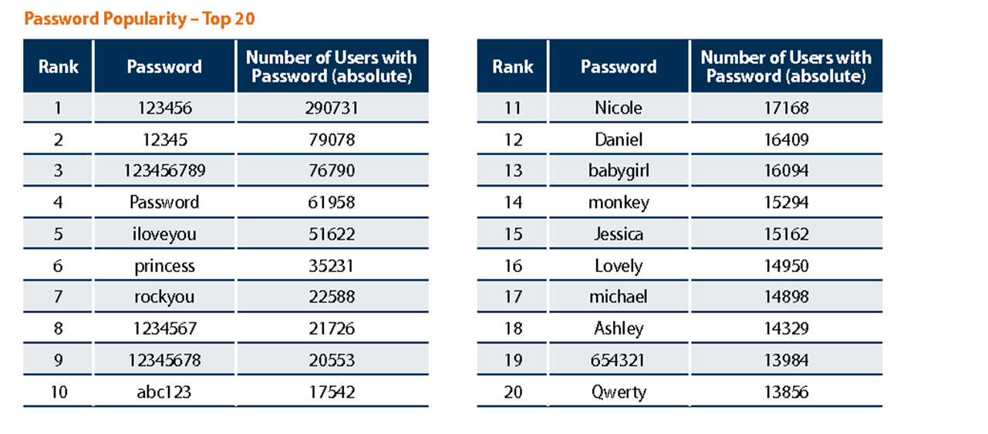
Passwords in the RockYou Database
Source: Imperva

Slide 17
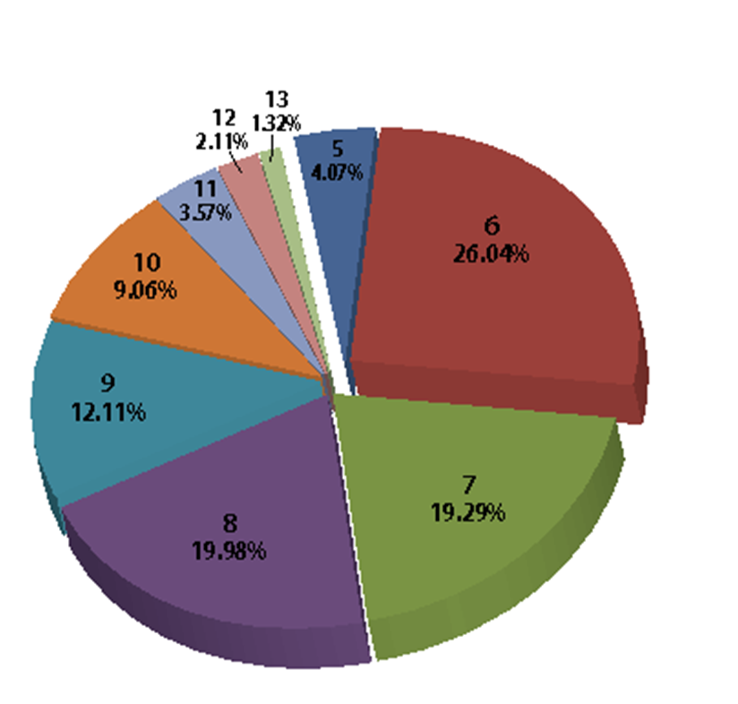
Password Length Distribution
Source: Imperva

Slide 18
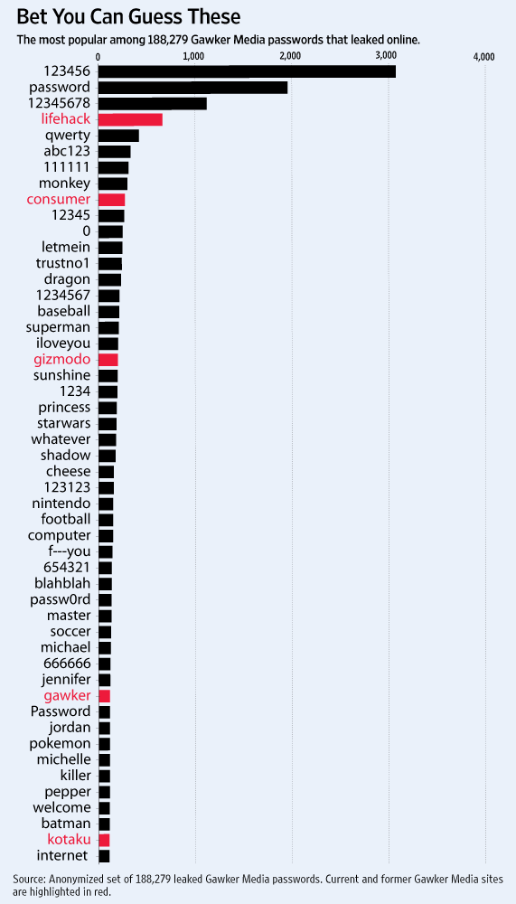
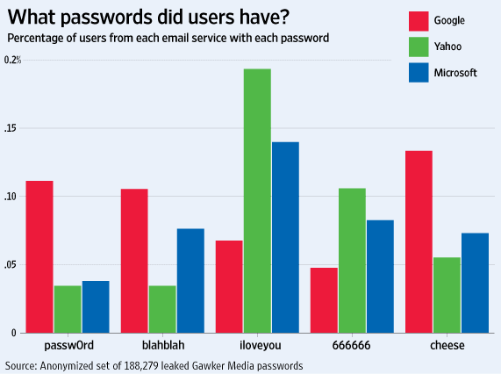
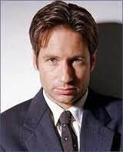
Gawker Passwords (2010)
trustno1
Source: WSJ

Slide 19
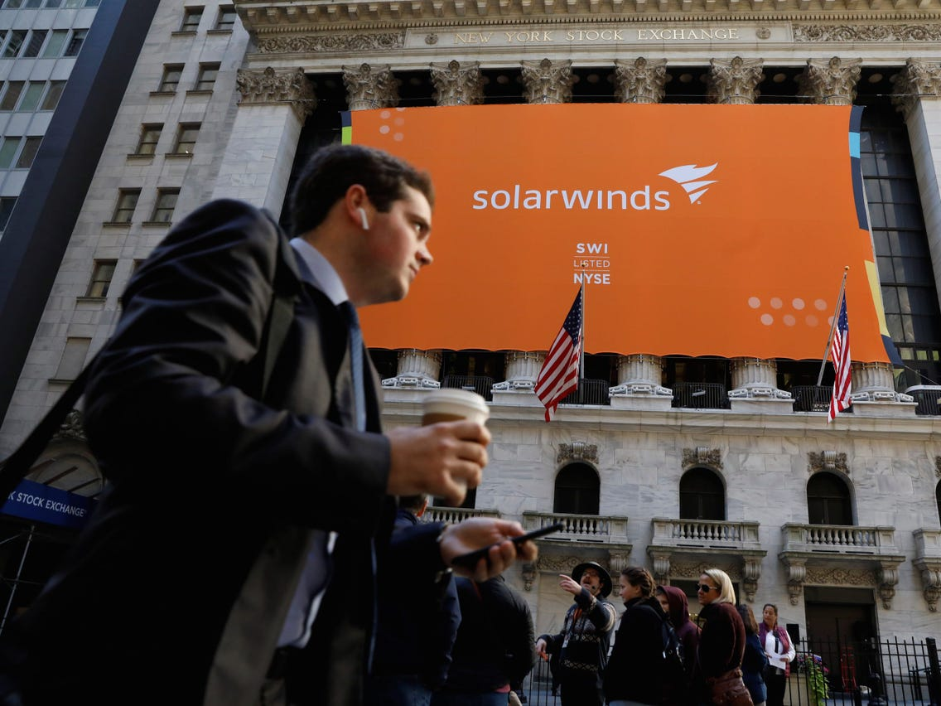
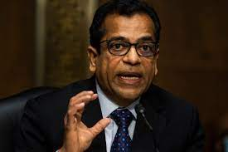

2020: major attack on US government and several companies via a compromised update to SolarWinds network management software
The company used the password solarwinds123 for a GitHub server
"I believe that was a password that an intern used on one of his Github servers back in 2017"
Company denied this was the source of the breach
SolarWinds CEO
Image: Insider

Slide 20
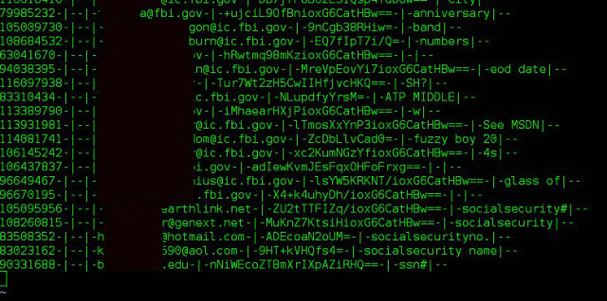
Adobe Passwords (2013)
153 million account passwords
56 million of them unique
Encrypted using 3DES in ECB mode rather than hashed (why is this important?)
Password hints

Slide 21
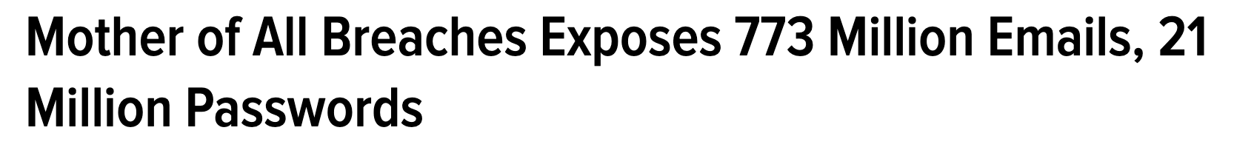
“Collection #1” (2018-2019)
… just a subset of the seller’s offerings
https://krebsonsecurity.com/2019/01/773m-password-megabreach-is-years-old

Slide 22
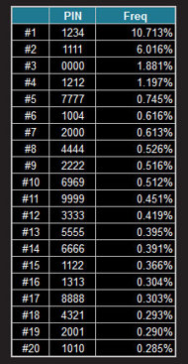
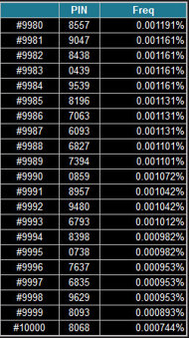
How About PINs?
In 2012, Nick Berry analyzed all four-digit passwords from previous leaks

Slide 23
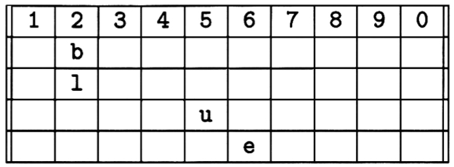
Memorability vs. Security
One bank’s idea for making PINs “memorable”
If PIN is 2256, write your favorite word in the grid
Fill the rest with random letters
Normally 9,999 choices for PIN –
hard(er) to guess
Now only a few dozen possible
English words – easy to guess!
Source: Ross Anderson

Slide 24
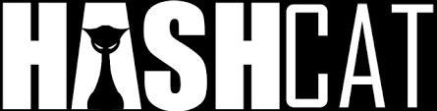

Cracking Techniques
Wordlists
20-500 million words and leaked passwords in publicly available lists
Mangling rules to generate variants
Dozens of thousands of rules (Korelogic, Megatron, Generated2)
Cracking tools
Example: John the Ripper, Hashcat

Slide 25
Password Mangling and Generation
Dictionary with words spelled backwards
First and last names, streets, cities
Same with upper-case initials
All valid license plate numbers in your state
Room numbers, telephone numbers, etc.
Letter substitutions and other tricks
If you can think of it, attacker will, too!

Slide 26
Social Engineering
Univ. of Sydney study (1996)
336 CS students emailed asking for their passwords
Pretext: “validate” password database after suspected break-in
138 returned their passwords; 30 returned invalid passwords; 200 reset passwords (not disjoint)
Treasury Dept. report (2005)
Auditors pose as IT personnel attempting to correct a “network problem”
35 of 100 IRS managers and employees provide their usernames and change passwords to a known value

Slide 27
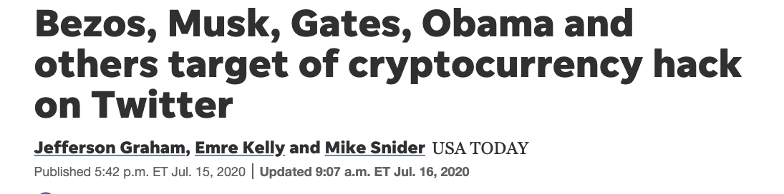
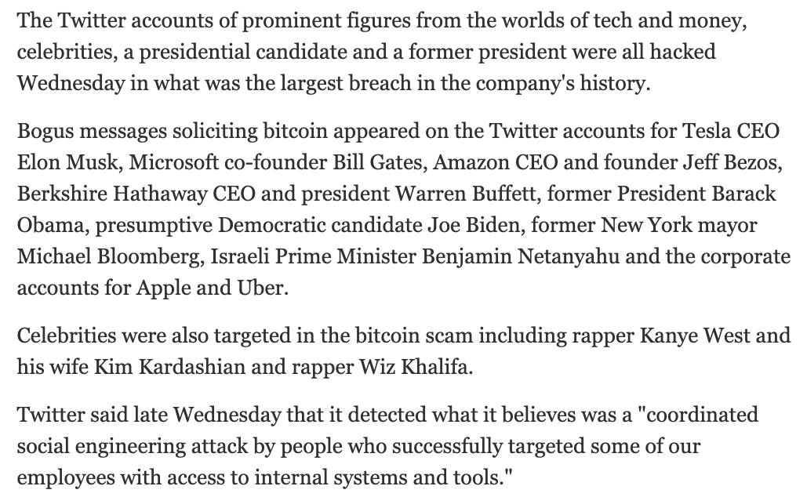

Slide 28
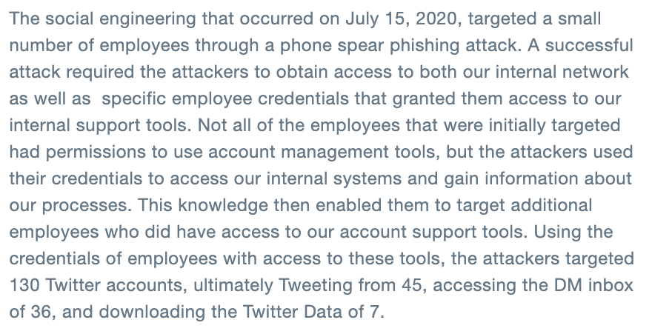
July 2020 Twitter Hack
https://blog.twitter.com/en_us/topics/company/2020/an-update-on-our-security-incident.html

Slide 29
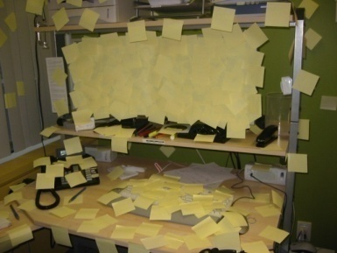
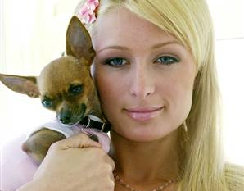
How People Use Passwords
Write them down
Use a single password at multiple sites
Do you use the same password for Amazon and your bank account? NetID? Do you remember them all?
Forget them… many services use “security questions” to reset passwords
“What is your favorite pet’s name?”
Paris Hilton’s T-Mobile cellphone hack

Slide 30
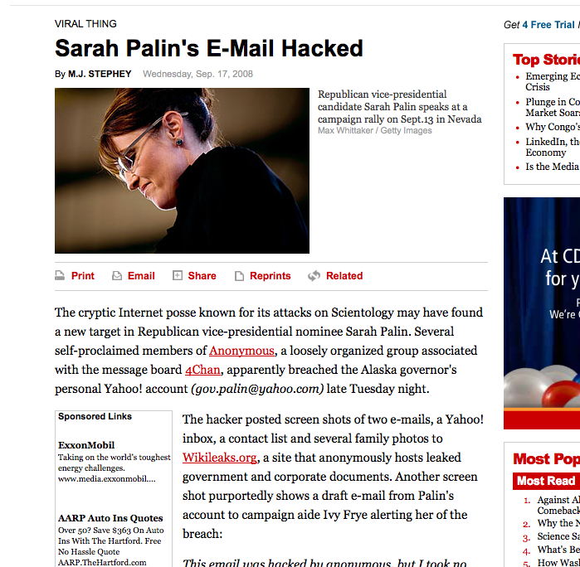
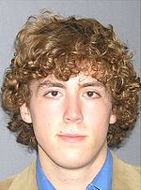
Sara Palin’s Email Hack
Reset password for gov.palin@yahoo.com
No secondary email needed
Date of birth?
ZIP code?
Where did you meet your spouse?
Changed pwd to “popcorn”
Hacker sentenced to
1 year in prison +
3 yrs of supervised release
Wikipedia
Wasilla has 2
Wikipedia, Google, …
slide: Gustav Rydstedt

Slide 31
Problems with Security Questions
Rabkin, “Security questions in the era of Facebook”
Inapplicable
What high school did your spouse attend?
Not memorable
Name of kindergarten teacher? Price of your first car?
Ambiguous
Name of college you applied to but did not attend?
Easily guessable
Age when you married? Year you met your spouse? Favorite president? Favorite color?
Automatically attackable (using public records!)

Slide 32
Answers Are Easy to Find Out…
Or Easy to Forget
Make of your first car?
Until 1998, Ford had >25% of market
First name of your best friend?
10% of males: James/Jim, John, Robert/Bob/Rob
Name of your first / favorite pet?
Max, Jake, Buddy, Bear…
Top 500 (covers 65% of names) available online
Information available from Facebook, etc.
Where you went to school, college athletic rivals, favorite book/movie/pastime, high school mascot
Name of the street, etc.
More than one
Name of your best friend?
Friends change
City where you were born?
NYC? New York? Manhattan? New York City? Big Apple?
People lie to increase security… then forget the answers

Slide 33
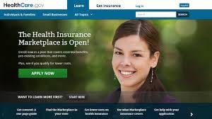

HealthCare.gov
Federal:
What is a relative's telephone number that is not your own?
Type a significant date in your life?
What is the name of the manager at your first job?
Individual states:
What is your youngest child's birth weight?
What color was your first bicycle?
If you needed a new first name, what would it be?
What band poster did you have on your wall in high school?
How many bones have you broken?

Slide 34
Password Management
Countermeasure | Purpose
Password hashing | Database leak doesn’t immediately reveal user passwords; slows offline guessing attacks
Strength meters | Nudge / force users to pick stronger passwords to mitigate guessing attacks
Lockout after N failed attempts | Prevent remote guessing attacks (X typically 10, 100, 1000); slows down / prevents online guessing attacks
Compromised credential checks | Check if password is in known breaches

Slide 35
Storing Passwords
“cypherpunk”
system password file
t4h97t4m43
fa6326b1c2
N53uhjr438
Hgg658n53
…
hash
function

Slide 36

Password Hashing
Instead of user’s password, store Hash(password)
When user enters a password, compute its hash and compare with the entry in the password file
System does not store actual passwords
Cannot go from hash to password
(except by guessing the password)
Hash function H must have some properties

Slide 37

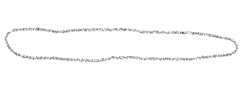


Cryptographic Hash Functions
Cryptographic hash function H maps any message to a short digest (e.g., 256-bit string)
One-way:
Given y = H(M), hard to compute M
Collision-resistant:
Can’t find M, M’ s.t. H(M) = H(M’)
Good hash functions: SHA256, SHA512, SHA-3, bcrypt, scrypt, PBKDF2 …
Deprecated hash functions: MD5, SHA-1
password-specific

Slide 38


Dictionary Attacks
Passwords are not random
With 52 upper- and lower-case letters, 10 digits and 32 punctuation symbols, there are 94⁸ ≈ 6 quadrillion possible 8-character passwords
Humans like to use dictionary words, human and pet names ≈ 1 million common passwords
Attacker can pre-compute H(word) for every word in the dictionary – do this once offline
Once password file is obtained, cracking is instantaneous
Sophisticated password guessing tools are available (take into account frequency of letters, password patterns, etc.)

Slide 39
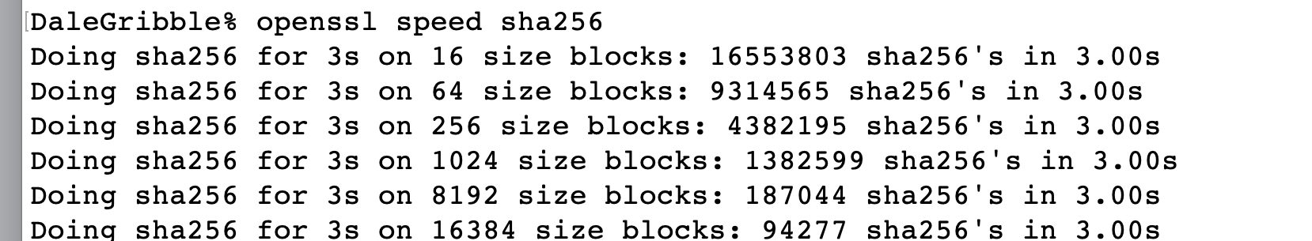
Brute-Force Password Cracking
~450,000 hashes per second
How many guesses / hashes needed to crack a password?
Also rainbow tables:
precompute huge number of hashes to make a quick-lookup table

Slide 40
Making Cracking Harder
Make hashing slower to slow down cracking attacks
Use random per-user salts to prevent use of rainbow tables
PKCS#5 approach:
Memory-hard hashing: Scrypt and argon2 require lots of memory to compute as well as time
pw || salt
H
H
…
H
h = H^{c}(pw || salt)
c times (e.g., c = 100,000)

Slide 41
Salt
shmat:fURxfg,4hLBX:14510:30:Vitaly:/u/shmat:/bin/csh
/etc/passwd entry
salt
(chosen randomly when
password is first set)
Password
hash(salt,pwd)
Users with the same password have different entries in the password file
Offline dictionary attack becomes much harder

Slide 42
Advantages of Salting
Without salt, attacker can pre-compute hashes of all common passwords once
Same hash function on all UNIX machines; identical passwords hash to identical values
One table of hash values works for all password files
With salt, attacker must compute hashes of all common passwords for each possible salt value
With 12-bit random salt, the same password can hash to 4096 different hash values

Slide 43
Modern Hash Cracking
… with custom GPU and FPGA hardware
IBM X-Force “Cracken”
(circa 2017)
https://medium.com/@ScatteredSecrets/how-to-crack-billions-of-passwords-6773af298172

Slide 44
Measuring Password Strength
Hashing slows down but does not prevent guessing attacks
Deprecated approaches for measuring password strength
NIST entropy estimate
Shannon entropy
Today: strength meters based on guess ranks

Slide 45
Shannon Entropy
Let X be password distribution
Passwords are drawn iid from X
N is size of support of X
p₁ , p₂ , …, p_{N} are probabilities of
passwords in decreasing order
Shannon entropy:

Slide 46
Poor Measure of Guessability
N = 1,000,000
p₁ = 1 / 100
p₂ = (1 – 1/100)/999,999 ≈ 1 / 2²⁰
…
p_{N} = (1 – 1/100)/999,999 ≈ 1 / 2²⁰
.01
H∞(X) = - log p₁ ≈ 6.6
The min-entropy of X
2⁻²⁰
H₁(X) ≈ 19
19 bits of “unpredictability”. Probability of success about 1/2¹⁹ ?
What is probability of success if attacker makes one guess?
Shannon entropy is almost never useful measure for security

Slide 47
RockYou Empirical Probability
~1% of time:
First guess is correct
(Only first 5,000
points shown)

Slide 48
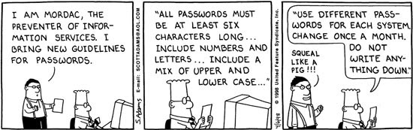
Password Policies

Slide 49
Password Policies
Overly restrictive password policies…
7 or 8 characters, at least 3 out of {digits, upper-case, lower-case, non-alphanumeric}, no dictionary words, change every 4 months, password may not be similar to previous 12 passwords…
… result in frustrated users and less security
Burdens of devising, learning, forgetting passwords
Users construct passwords insecurely, write them down
Can’t use their favorite password construction techniques (small changes to old passwords, etc.)
“An item on my desk, then add a number to it”
Heavy password re-use across systems
Inglesant and Sasse, “The True Cost of Unusable Password Policies”

Slide 50
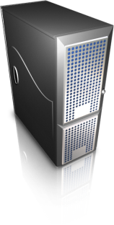
Credential Stuffing (Password Spraying)
Attacker tries multiple credentials from known breaches
POST /login.html?name=bob&pw=12345
Is (Bob, 12345) in a public breach?
If yes, ask user to choose new password
Breach database
Third-party services for making such queries:
HaveIBeenPwned
Google password checker

Slide 51
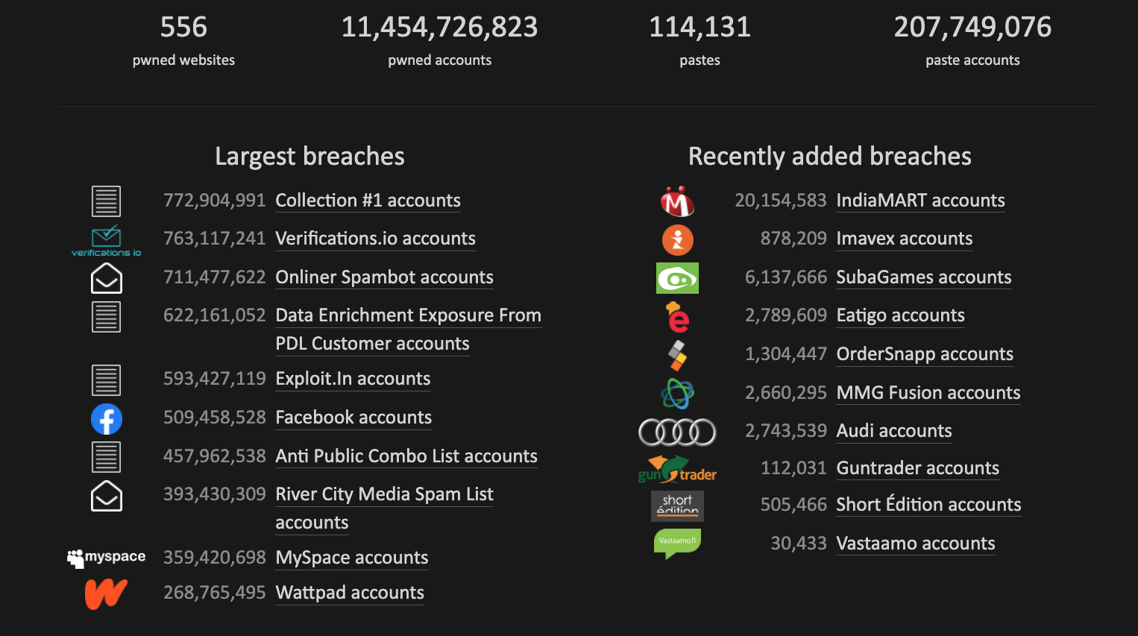
Have I Been Pwned

Slide 52

STRONTIUM Attacks
aka Fancy Bear, aka APT28, aka Sofacy
(GRU, Russian military intelligence)
Microsoft has tied STRONTIUM to a newly uncovered pattern of Office365 credential harvesting activity aimed at US and UK organizations directly involved in political elections
…
STRONTIUM relied heavily upon spear phishing in its credential harvesting efforts leading up to the 2016 US presidential election. In 2016, spear-phishing was the most common tactic for stealing credentials from targeted accounts. This time around, STRONTIUM appears to be taking a different approach, namely, brute-force/password-spray tooling. This shift in tactics, also made by several other nation-state actors, allows them to execute large-scale credential harvesting operations in a more anonymized manner. The tooling STRONTIUM is using routes its authentication attempts through a pool of approximately 1,100 IPs, the majority associated with the Tor anonymizing service.
target: elections
spear-phishing to harvest credentials
password spraying
cover tracks using Tor
https://www.microsoft.com/security/blog/2020/09/10/strontium-detecting-new-patters-credential-harvesting/

Slide 53
Credential Tweaking Attacks
Suppose user changes password to 123456
Credential stuffing no longer works, but guessing attacker could try variants of 12345
Deep learning techniques to learn conditional probability distribution
p(pw’ | pw) where pw is leaked password, pw’ is variant
Trained from leak data to capture typical password variants
Experiments showed that 1,316 Cornell accounts vulnerable (Pal et al. 2019)

Slide 54
Password Management
5 minutes to brainstorm ideas for how to improve password-based authentication

Slide 55
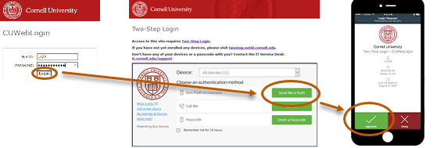
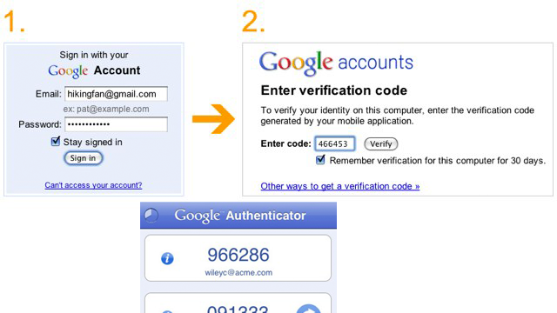
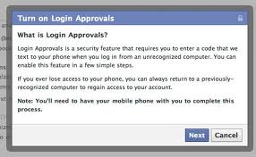
Multi-Factor Authentication

Slide 56
Factors for 2FA
Combine passwords with another way to authenticate user
Second factor is usually proof of ownership of …
Email address
Telephone number (via SMS)
Device (via authenticator app)
Hardware token (one-time-password token, universal second factor U2F token)

Slide 57
SMS Authentication
POST /login.html?name=bob&pw=12345
POST /smschall.html?code=9999
SMS: “Your auth code is 9999”
Suppose you know someone’s password (e.g., due to breach) but their account is protected by SMS-based 2FA. What can you do as an attacker?

Slide 58
Circumventing SMS-Based 2FA
Have physical access to device that receives SMS
Phishing attacks: confuse or trick user into disclosing SMS to you
SIM swap: trick phone company into registering victim’s phone # to your device
SMS hijacking: exploit vulnerabilities in cellular network
https://berlin.ccc.de/~tobias/31c3-ss7-locate-track-manipulate.pdf
[Doerfler et al. 2019]: SMS 2FA circumvented in ~4% of phishing attacks, ~26% of targeted attacks
Better practice: authenticator app or hardware token

Slide 59
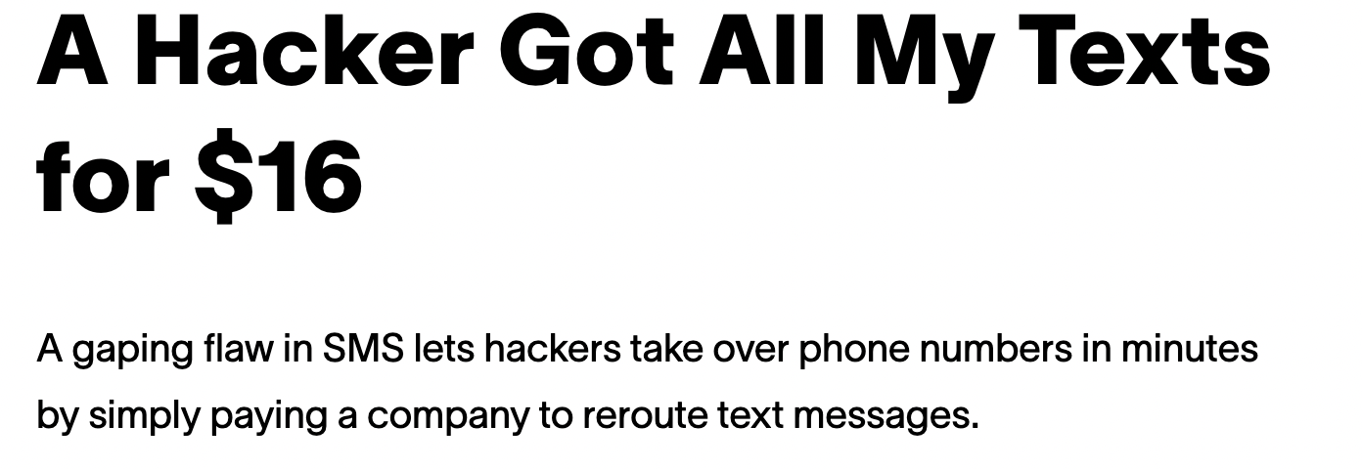

SMS Rerouting
The OSR database is a core component of the message routing infrastructure in North America … It is known as an "override registry" as it enables an individual subscriber to receive messaging services from a different provider than voice services.
"I used a prepaid card to buy their $16 per month plan and then after that was done it let me steal numbers just by filling out LOA info with fake info," Lucky225 added, referring to a Letter of Authorization, a document saying that the signer has authority to switch telephone numbers.
Not SIM swapping or phone number hijacking
The victim doesn’t notice (phone service not interrupted)
https://www.vice.com/en/article/y3g8wb/hacker-got-my-texts-16-dollars-sakari-netnumber

Slide 60
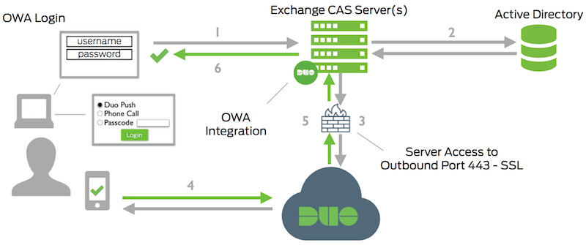
Duo 2FA Authentication
https://duo.com/docs/owa

Slide 61
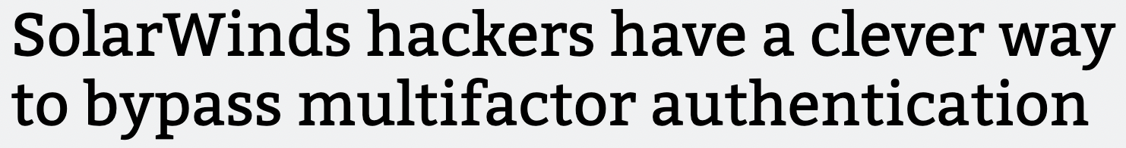
… the attacker had accessed the Duo integration secret key (akey) from the OWA server. This key then allowed the attacker to derive a pre-computed value to be set in the duo-sid cookie. After successful password authentication, the server evaluated the duo-sid cookie and determined it to be valid. This allowed the attacker with knowledge of a user account and password to then completely bypass the MFA set on the account.
More about Web authentication later
https://arstechnica.com/information-technology/2020/12/solarwinds-hackers-have-a-clever-way-to-bypass-multi-factor-authentication/

Slide 62
Usability remains a key issue preventing adoption

Slide 63
Other Authentication Signals
Location-based authentication
IP-based geolocation
Device identification
Cookies, device fingerprinting
Behaviorial cues
Typical actions on platform (even after authenticated)
Biometrics
Fingerprints, etc

Slide 64
User Authentication Is a Huge Pain
Simple typos in passwords cause 3% of Dropbox users to be unable to login in a 24-hour period [Chatterjee et al. 2016]
52% of users fail login challenges at Google, 3% don’t get in within short period of time [Doerfler et al. 2019]

Slide 65
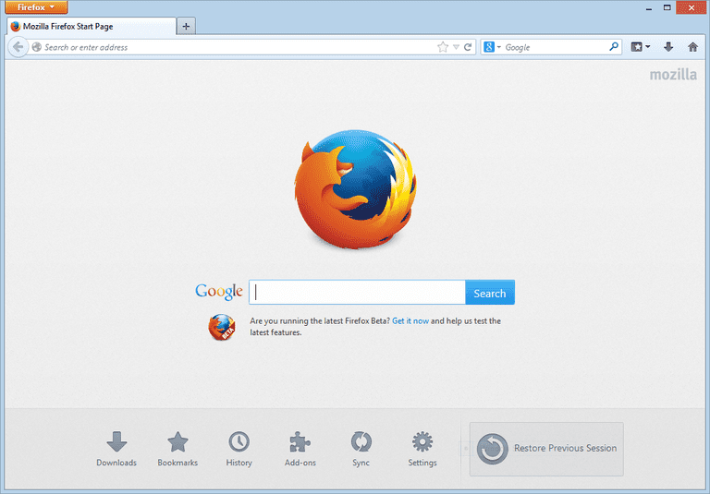
Single Sign-On (SSO)
In-class 5-minute exercise:
How would you securely authorize browser to access www.cornell.edu/account.html?user=vitaly based on authentication to identity.cornell.edu?
Identity provider handles authentication
Google, Facebook, proprietary services, etc.
Identity provider
(e.g., identity.cornell.edu)
Relying party (RP)
(e.g., account.html?user=vitaly)

Slide 66
Single Sign-On (SSO)
Many standards and systems: SAML, OpenID Connect + OAuth 2.0, …
Give me permissions for account.html as vitaly
Identity provider
(e.g., identity.cornell.edu)
Auth token
Give me account.html?user=vitaly, here is the token
Vitaly’s account page
Relying party (RP)
(e.g., account.html?user=vitaly)
Must check validity of token!
More about OAuth later…

Slide 67
Strengthening Passwords
Add biometrics
For example, keystroke dynamics or voiceprint
Revocation is often a problem with biometrics
Graphical passwords
Goal: increase the size of memorable password space
Dictionary attacks are believed to be difficult because images are very “random” - is this true?

Slide 68
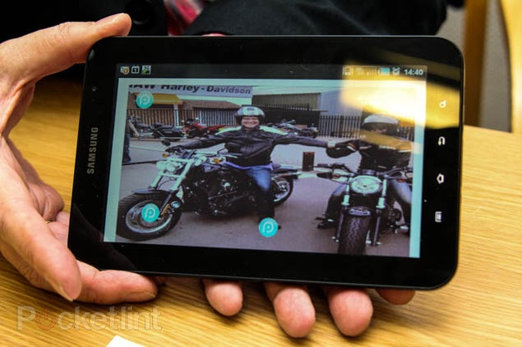
PixelPin
Upload a picture,
use 3 or more points as the “password”
random?

Slide 69
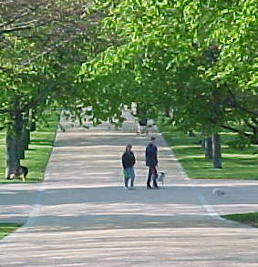


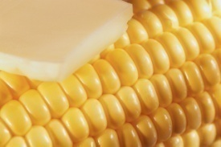
Images + Story
Invent a story for an image
or a sequence of images
“We went for a walk
in the park yesterday”
Fish-woman-girl-corn
Need to remember the order!

Slide 70
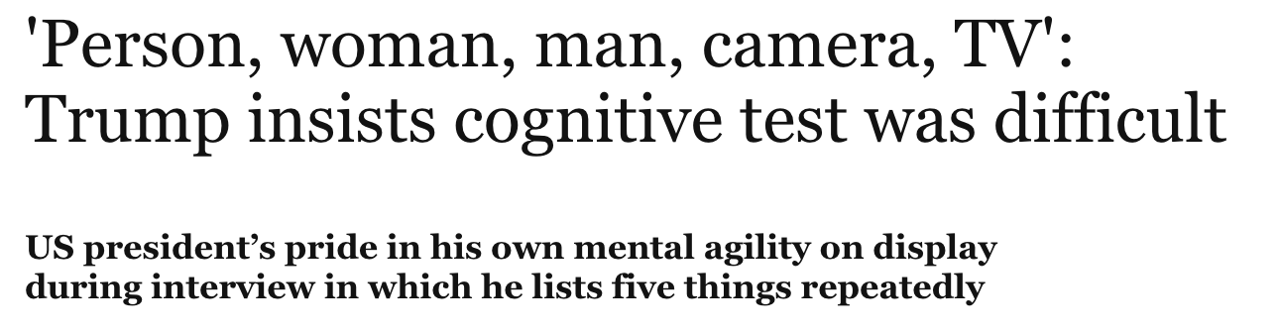


Slide 71
User Experiences
50% unable to invent a story, so try to pick four pleasing pictures and memorize their order
“I had no problem remembering the four pictures, but I could not remember the original order”
“… on the third try I found a sequence that I could remember, fish-woman-girl-corn. I would screw up the fish and corn order 50% of the time, but I knew they were the pictures”
Picture selection biases
Males select nature and sports more than females
Females select food images more often

Slide 72









Alternatives to Passwords
Mobile phones,
USB devices,
special tokens,
etc. etc.
LaunchKey

Slide 73



Alternatives from Motorola
“… you can be sure that they'll be far more interested in wearing an electronic tattoo, if only to piss off their parents”
“The pill features a small chip with one switch that uses your stomach acids to activate an 18-bit ECG-like signal inside your body”

Slide 74
One-Time Passwords
Idea: use a shared secret to derive a one-time password
If the attacker eavesdrops on the network, he’ll learn this password but it will be useless for future logins

Slide 75
Challenge-Response
secret
secret
user
system
challenge value
f(secret,challenge)
Why is this better than the password over a network?

Slide 76
Challenge-Response Authentication
User and system share a secret (key or password)
Challenge: system presents user with some string
Response: user computes the response based on the secret and the challenge
Secrecy: difficult to recover secret from response
Cryptographic hashing or symmetric encryption work well
Freshness: if the challenge is fresh, attacker on the network cannot replay an old response
Fresh random number, counter, timestamp….
Good for systems with pre-installed secret keys
Car keys; military friend-or-foe identification

Slide 77

SecurID
KEY
KEY
Setup: generate random key
Counter:
Counter:
0
1
…
0
1
…
v= F(KEY, 0)
?
v= F(KEY, 1)
Verifies v=F(KEY,0)
?
Alice
Bob
Verifies v=F(KEY,1)
…
Advancing the counter
Time-based (60 seconds) or every button press
Allow for skew in the counter value
5-minute clock skew by default
RSA uses a custom function
Input: 64-bit key, 24-bit counter
Output: 6-digit value

